Slide 2
AGENDA
2019 Q2 Review
9:00 | New business
9:15 | Sales & Marketing updates
9:45 | Annual Donations Program
9:50 | Q&A
Notes:
Shape with edited points
Table

Slide 3
E-Commerce Opportunity
Notes:
Line chart, with “Percentage of Market” line made 100% transparent, so it doesn’t show up on the plot area

Slide 4
Leveraging E-Commerce
Online sales account for more than 50% of sales in most manufacturing areas
Expected to grow by more than 20% by 2021
Greatest opportunity is in software and cloud services
Expect 3D printing to gain momentum over next 5 years
Impact on several industries including printing, paper, machinery, and fabrication
Major growth opportunity for us

Slide 5
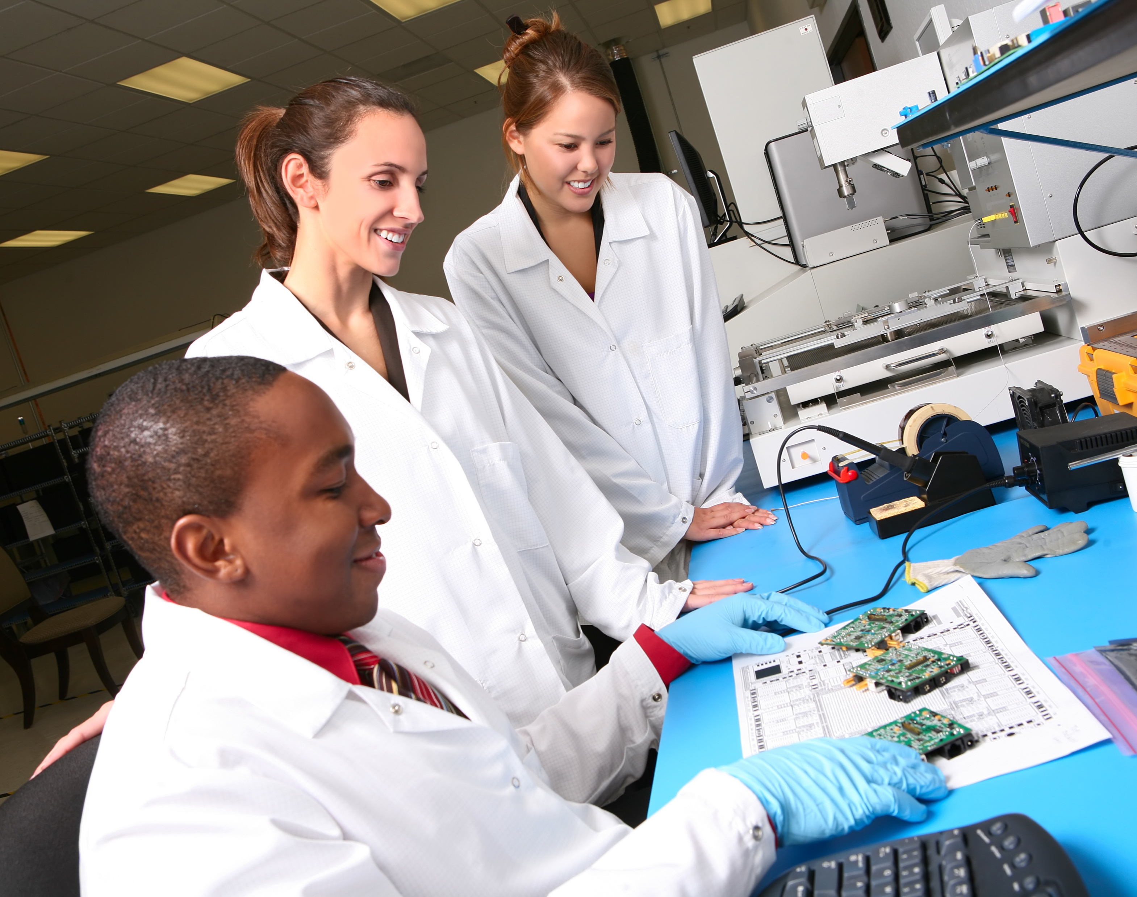
R&D Project Updates
DX-145 Drone (previously R-145) scheduled to release in Q1
RTE-QFN20 delayed due to increased materials demand – 2018 Q2 release

Slide 6
Rechargeable Battery Comparison
 | Lead Acid | Nickle Cadmium (NiCad) | Nickel-Metal Hydride (NiMH) | Lithium Rechargeable
Pros | High power density, wide temperature range | Wide temperature range, long shelf life, inexpensive | Lower cost, high current ability | High energy density, long lasting
Cons | Low energy density, heavy, large | High toxicity, low energy density | Can overcharge, short storage life | Expensive, require protection, ageing
Application | Battery banks, car batteries, golf carts, wheelchairs, electric scooters | Portable electronics, toys, cordless phones, remote controlled devices | Remote controlled devices, drones, portable devices, cameras | Cell phones, electronic watches, electric vehicles, laptops, power tools
Shelf Life | ~8 years | 1-3 years | ~3 years | ~3 years
Cycle Life | 200-300 cycles | 2,000 cycles | 800-2,000 cycles | 800-1,000 cycles

Slide 7

Sales and Marketing Updates

Slide 8
Jenny Torres
B2B Account Executive
Sharon Wu
Enterprise Sales Executive
Devon Harris Director of Sales & Marketing
Notes:
Smart art: alternating picture blocks

Slide 9
Q2 Sales

Slide 10
3D Printing Engagement and Trends
75% of people who’ve tried 3D printing would recommend it to their friends
More than 5 million 3D Printers will be sold in 2019
80% of consumers show interest in using 3D Printing at home
An estimated 40 million people worldwide will be 3D Printing in 2019

Slide 11
2019 Conversion Goals
Opportunity
Advocacy
Exploration
Decision Making
Purchase
Plan
Up 3.1% year-over-year
E-book conversion up 0.9%
Largest gain in software (7.1%)
2019 increase overall conversion by 5%
Reach
Act
Convert
Engage
Notes:
Inverted Pyramid Smart Art, with shape changed to a trapezoid. 3D bevel, top and bottom. Rectangle shapes, arrow shapes

Slide 12
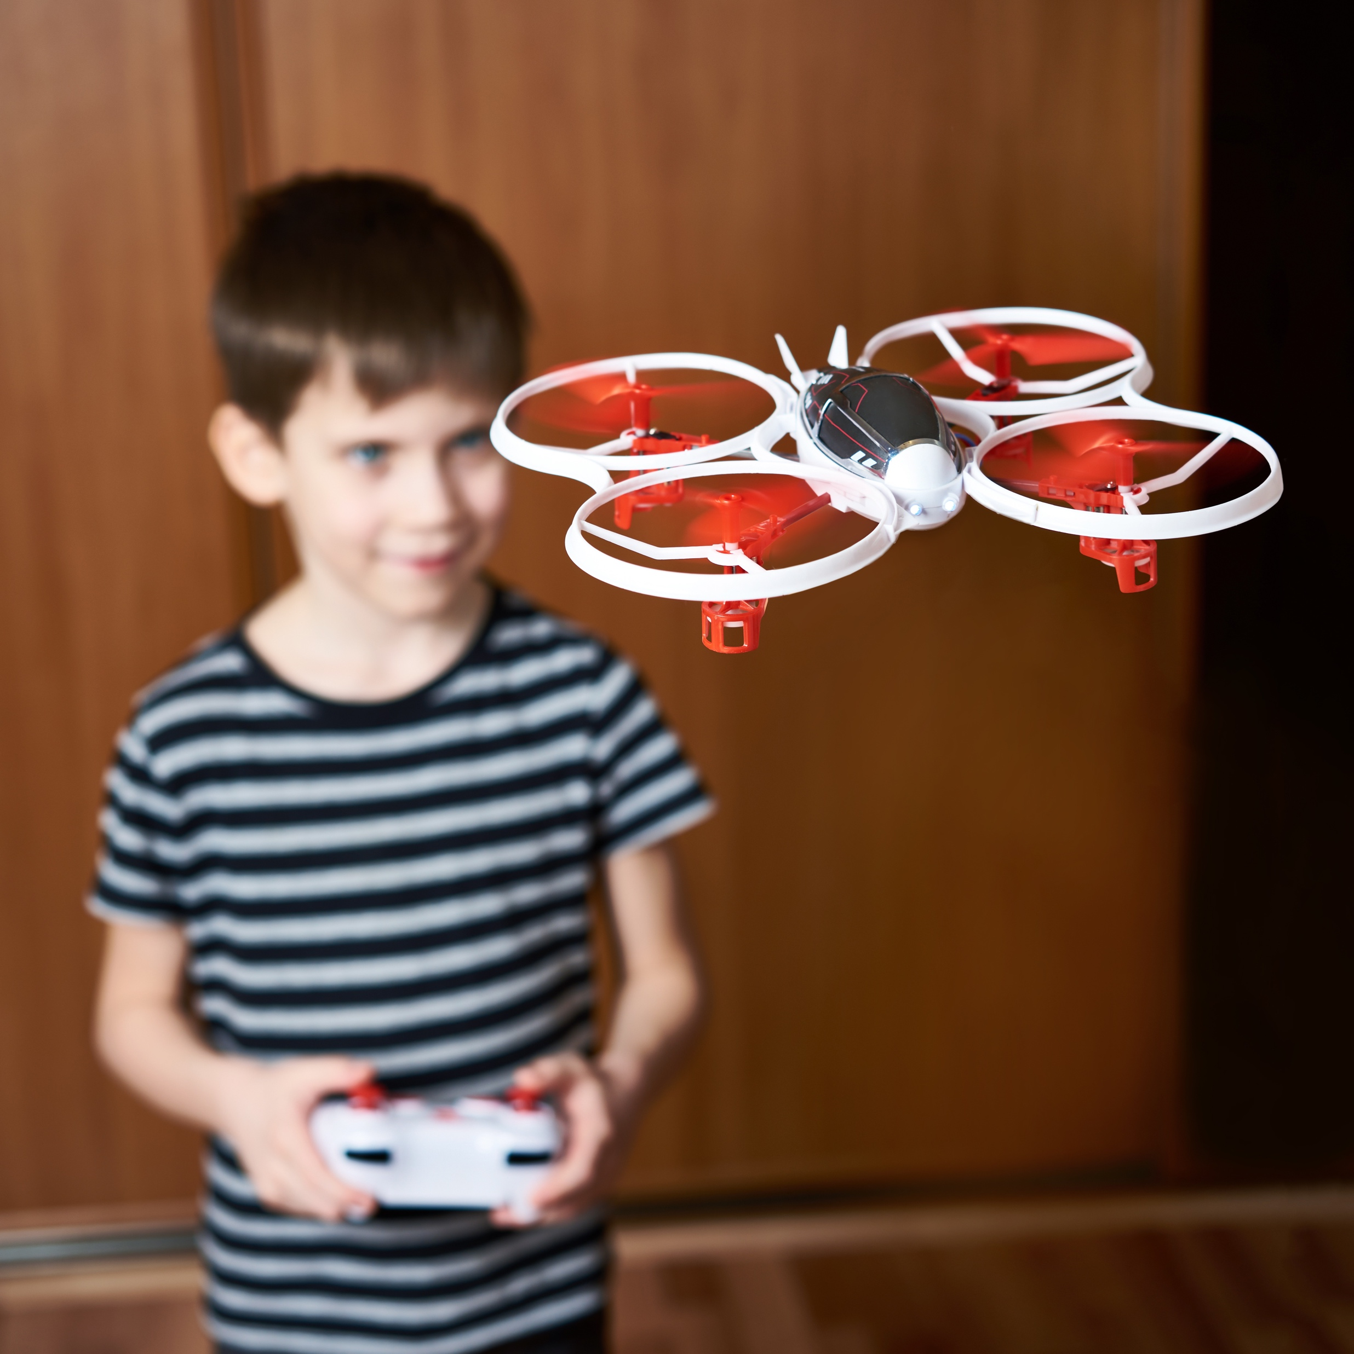

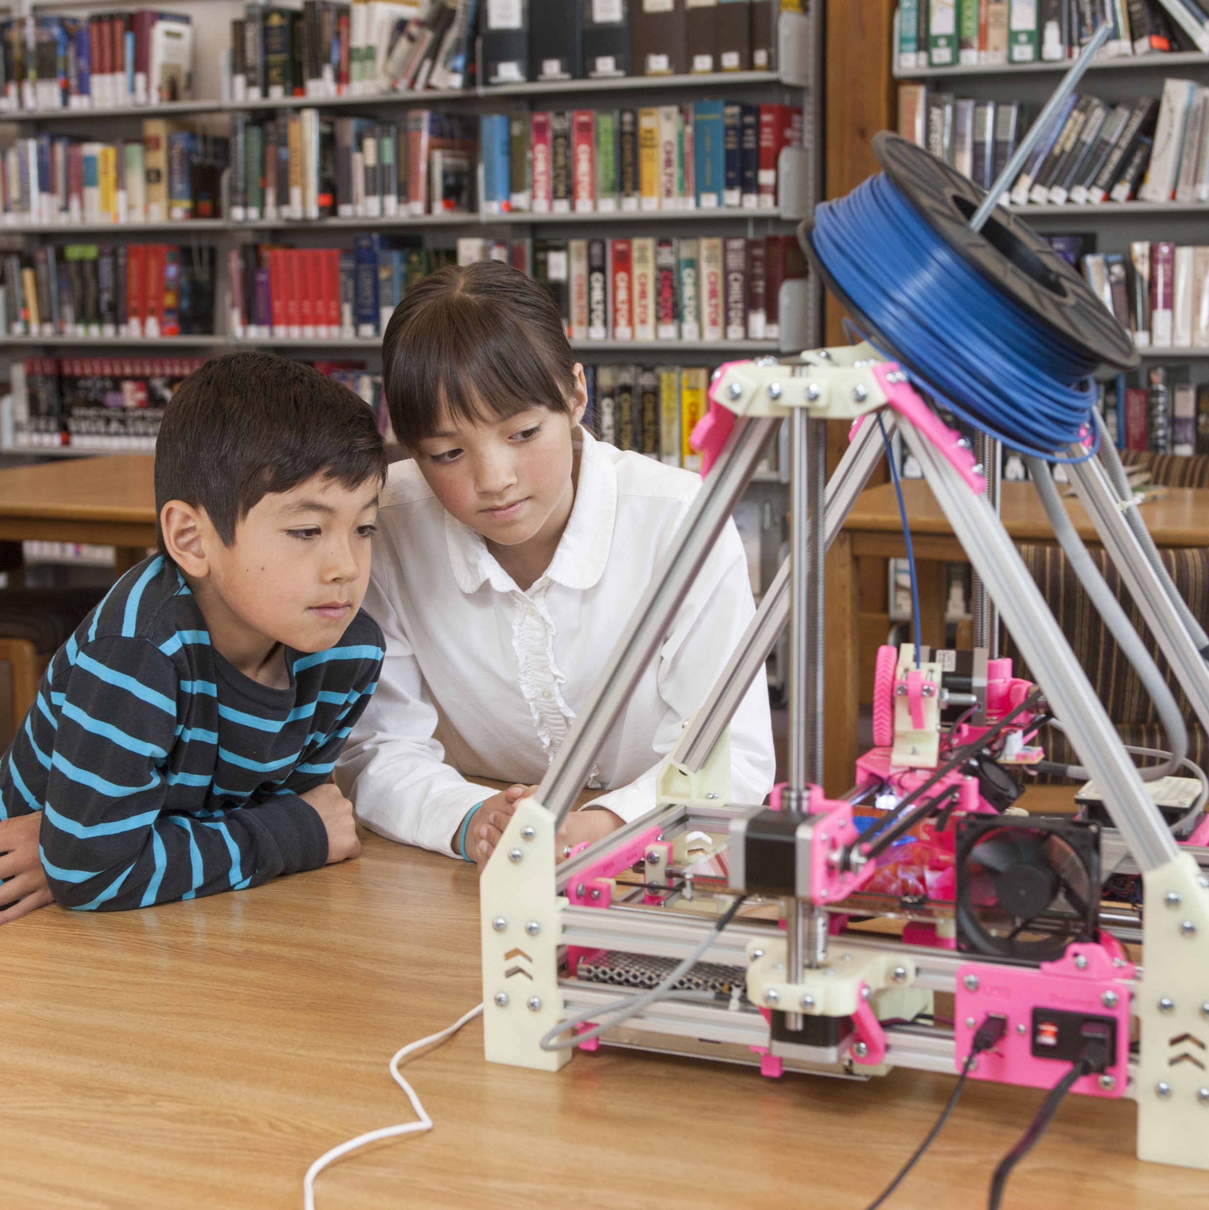
Annual Donations Program
Last year, we donated 100 drones to STEM programs across Ohio
41 employees volunteered to teach robotics to students
Abel Gomez’s children acted as 3D Printing mentors for their classmates!
Starting in October, RED30 will match employee donations to local Robotics programs 1:1 (up to $1000/employee)
Notes:
Multi-photo slide with captions layout

Slide 13
So far, 4 local schools are signed up
Orange Valley Academy
Orange Valley High School
Windy Peak High School
Two Trees Middle School

